Slide 1
Volunteer Movie Scheduler Achievatron Unlimited
Group 06
Iain Workman, John Mason, Ryan La Forge , Matthew Galbraith, Mitchell Corbett

Slide 2
Motivation/Business Case
Being a film producer is a tricky business
Equipment, Shooting Days, Volunteers
Managing all these resources in order to produce anything is like herding cats.
No current tool does the job (except Excel)
Can We do better than Excel?

Slide 3
Motivation/Business Case
Being a film producer is a tricky business
Equipment, Shooting Days, Volunteers
Managing all these resources in order to produce anything is like herding cats.
No current tool does the job (except Excel)
Can We do better than Excel?
ALWAYS!

Slide 4
So what can be done?
A system in 5 parts
Resources – Volunteers and Equipment
Traditional name, and contact info
A list of time periods for which they are available for filming
Script and Scenes
Each script has multiple scenes to be filmed
Each scene has a number of resources that are needed to film it

Slide 5
So what can be done?
The schedule
A list of time intervals over which each scene will be filmed
Essentially this is the core of what the system is helping the producer to organize
Conflict Management
Allows the producer to contact Volunteers when a scene cannot be scheduled
Volunteer Application
Allows each volunteer to update their information and availabilities themselves

Slide 6
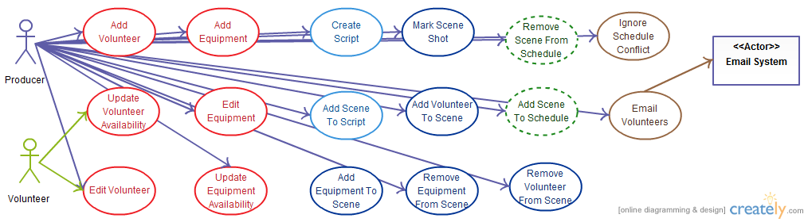
Use case diagram

Slide 7
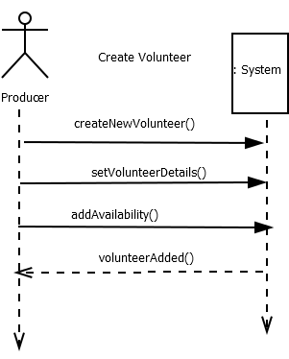
Sequence Diagram

Slide 8
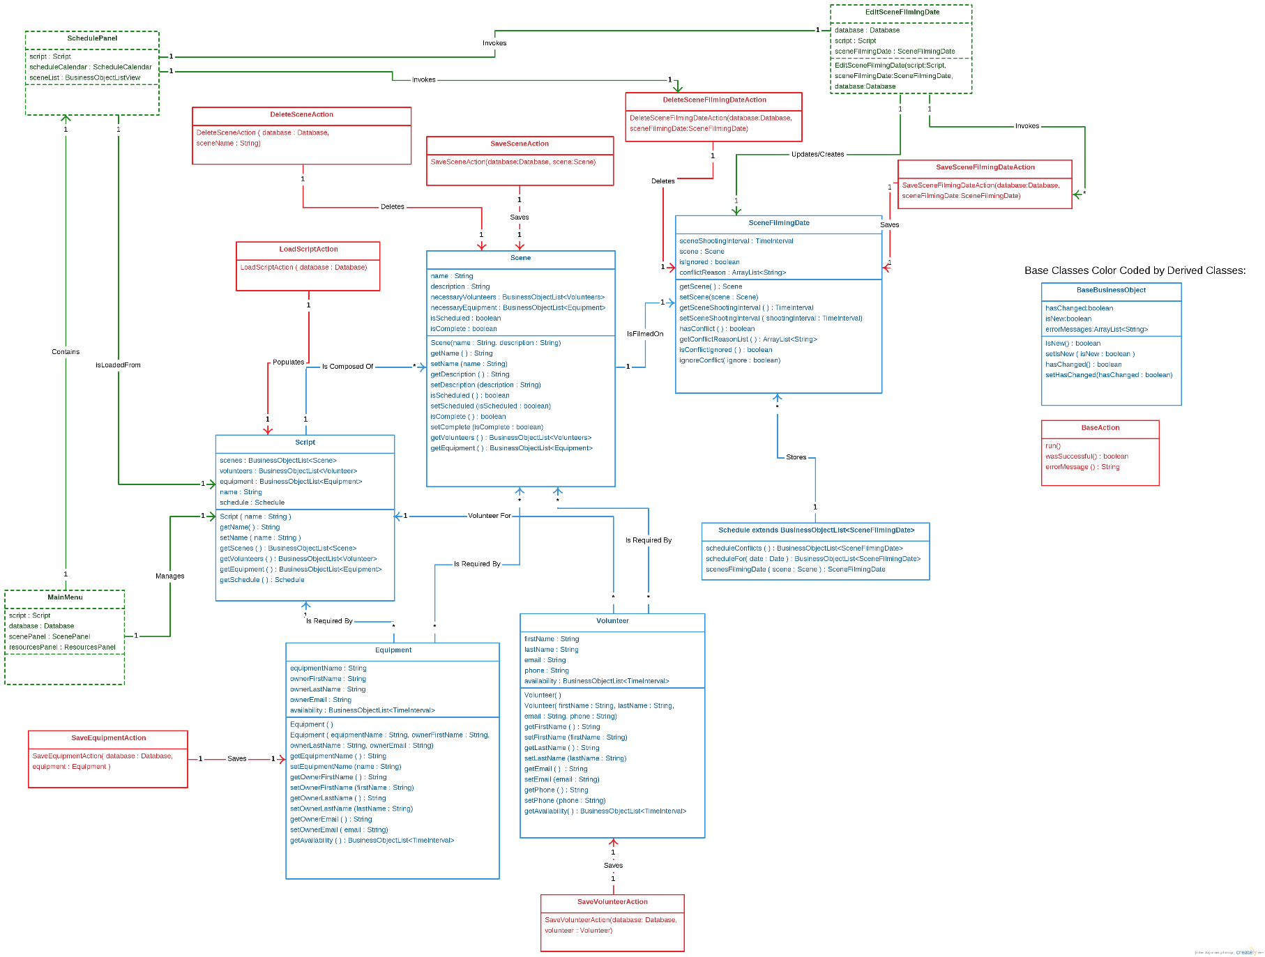
Class Diagram

Slide 9
What have we done so far?
Success Scenarios Achieved(atron)
Volunteer Application
Can log in
Can update details and availabilities of logged in Volunteer
Resources – Volunteer and Equipment
Can create new Volunteers and Equipment
Can add/remove Volunteers and Equipment to/from a Scene
Can update the times which Volunteers and Equipment are available

Slide 10
What have we done so far?
Success Scenarios Achieved(atron)
Schedule
Can add and remove Scenes to and from the Schedule
Provides feedback on which Scenes can and Can’t be shot
Script and Scenes
Can create Script
Can add new Scenes to Script
Can add required Volunteers and Equipment to Scenes
Conflict Management
Can email relevant Volunteers when a Scene cannot be scheduled
Can ignore a conflict in a Schedule

Slide 11
Challenges
We didn’t know what we didn’t know when we started
Getting this stuff right at the beginning is all important
Lots of time was wasted, lots of work had to be redone – both in documentation and implementation
So, yeah…third year

Slide 12
Other Issues
Initial API was designed to be general purpose, and expandable
A noble aim, but for a project of this scope…maybe not so much.
Time that should have been spent getting the implementation done was spent learning the API
Java: No one’s first choice
javax.swing: Everyone’s last choice (at least now)
Git: Cross platform problems

Slide 13
Conclusion
We set out to learn how to build a software product that could be used outside of the classroom and we succeeded.
After all of the hours spent staring at computer screens, joking with each other in group-chat, and all of the endless collaborating we have managed to fit all of the building blocks of code into a working project.
Our plan to create an information database and scheduling application, specifically tailored to a producer working with volunteers, has come together.
Sometimes we got things right the first time sometimes the tenth. More often than not we learned by getting it wrong (hello cluttered main menu, hello model-view-controller)
By stumbling around in the dark on this project and trying to do things our own way we invariably learned why the standard techniques exist and why it is much better to design first code second. We learned to appreciate how much easier following a design pattern made things.
The next time we attempt to build a piece of software we will be better prepared because of the skills we learned together in this course.

Slide 14
DEMO TIEM
Thanks for listening!

